Slide 1


Part 2: God exists, but is He good?
What does the Bible say about evil concerning Christians?
A word study in 1 Peter
Ephesians 4:13-15

Slide 2
Part 2: God exists, but is He good?
Picking and Choosing our moral tragedies (Greg Koukl)
2012 Sandy Hook Elementary School
  How many Americans that same day…
  Sins that day were multiplied thousands of times over.
  There were no outcries on the nightly news.
Ephesians 4:13-15

Slide 3
The problem of evil is much bigger than Sandy Hook or 9/11
It includes all ordinary corruptions…
Hundreds of small vices and sins…
It entails not only what offends us, but offends…
Apologetics replaces lies with the truth.
Ephesians 4:13-15

Slide 4
“The discomforting reality is that evil deeds can never be isolated from the evil doer. Each one of us is guilty in some capacity, and we know it…that’s the problem.” - Koukl
Apologetics replaces lies with the truth.
Ephesians 4:13-15

Slide 5
Why doesn’t God stop the evil in the world?
Why doesn’t God stop me…
If God stopped evil at 12:00 am, where would you and I be at 12:01 am?
Apologetics replaces lies with the truth.
Ephesians 4:13-15

Slide 6
“We don’t complain when evil makes us feel better, only when it makes us feel bad. If the truth were known, we do not judge disasters based on unprejudiced moral assessment, but rather on what is painful, awkward, or inconvenient to us. We only cry “foul” when He doesn’t stop others from hurting us.” – Koukl
Apologetics replaces lies with the truth.
Ephesians 4:13-15

Slide 7
Why doesn’t God do something about evil?
God is patient (2 Peter 3)
Apologetics replaces lies with the truth.
Ephesians 4:13-15

Slide 8
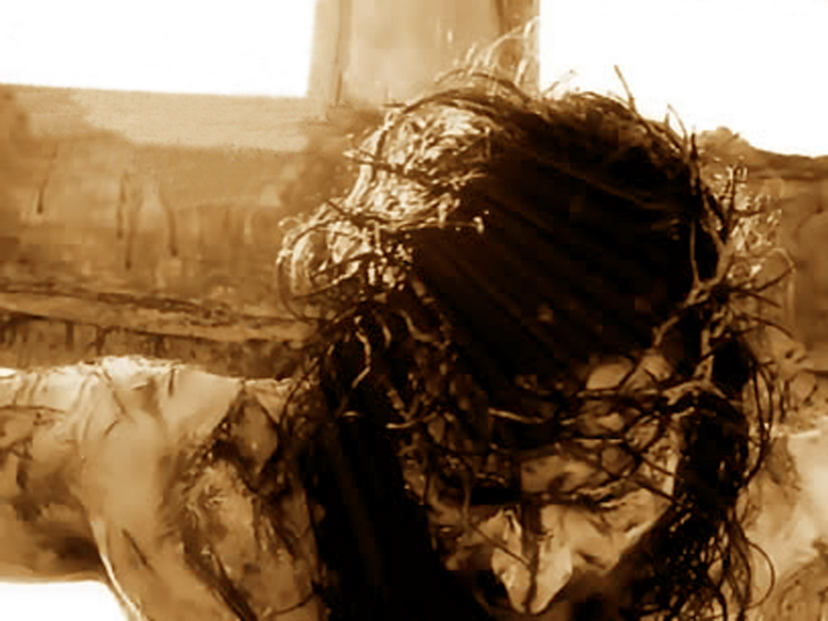
The Gospel
God allows us to commit evil, but then takes our evil on himself so we can go free…
Apologetics replaces lies with the truth.
Ephesians 4:13-15

Slide 9
“Our dilemma should not be why God allows evil. Instead, our wonder should be why He would pay such an incredible price to rescue us at all when we have rebelled so completely against Him. When this reality grabs our hearts, we will get down on our knees and ask forgiveness instead of criticizing God for not doing enough.” - Koukl
Apologetics replaces lies with the truth.
Ephesians 4:13-15

Slide 10
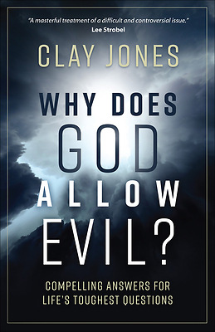

Slide 11

The Michigan School of Apologetics

