Slide 1

Class 4B: Evidences the Bible is the Supernatural
Word of God

Slide 2

Introduction:
“Can You read you a Scripture passage?”
Read Isaiah 53:3-10
First Question: “Who Does that Sound Like to you?”
Second Question: “So is that that Christian Scriptures written after Jesus? Or is this the Jewish Scriptures written before Jesus?”
Apologetics replaces lies with the truth.
Ephesians 4:13-15

Slide 3
Turn your Bible around and show the person this is from Isaiah 53
Isaiah 53 was written 700 years before Christ.
Conclusion: “How could Isaiah know about
Christ’s death for our sins? He couldn’t, this is called prophecy.”
“Prophecy is the fingerprint of God on the Bible that the Bible is from God, not from man.”
Apologetics replaces lies with the truth.
Ephesians 4:13-15

Slide 4
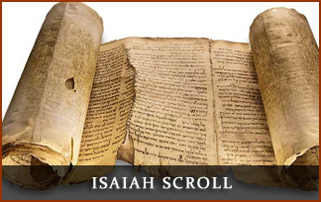
Google: “Great Isaiah Scroll”
Complete copy of Isaiah that dates 125 years before Christ.
Proving the Prophecy of Isaiah 53 was before Jesus lived.

Slide 5
Practice Together
Apologetics replaces lies with the truth.
Ephesians 4:13-15

